Slide 1
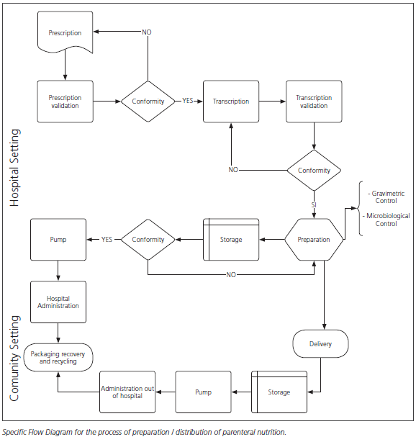
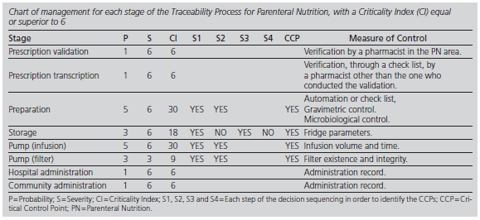
Application for the standardized development of traceability management
of parenteral nutrition in hospitals
Beatriz Bernabéu Soria - Universidad Miguel Hernández de Elche
Victor M. Alonso Rorís - Universidad de Vigo
Máxima Mateo García - Hospital General Universitario de Alicante
Carmina Wanden-Berghe - Hospital General Universitario de Alicante; Instituto de Investigación Sanitaria Y Biomédica de Alicante (ISABIAL-FISABIO)
Juan M. Santos Gago - Universidad de Vigo
Luis M. Álvarez Sabucedo - Universidad de Vigo
Javier Sanz-Valero - Universidad Miguel Hernández de Elche; ISABIAL-FISABIO
Email: jsanz@umh.es
SUN-P174
Rationale
To develop the traceability control and the hazard analysis in the processes of parenteral nutrients (PN).
Results
A specific flow chart for the management and traceability of PN was obtained, defining each of the stages in CPs (validation and transcription of the prescription and administration) or CCPs (preparation, storage and infusion pump–flow and filter-). Stages regarding the delivery, the recovery and the recycle of the packing material of PNs are not considered CPs and, therefore, they were not included in the dashboard.
Methods
A standardized graphical notation was generated, describing in detail each of the stages in the overall process. The presence of hazards was analysed by sequencing decisions. The existence of Control Points (CP) or Critical Control Points (CCP) was estimated by Criticality Index (CI) for each hazard taking into account the probability of occurrence and the severity of the damage. The threshold for the IC was set in 6.
Conclusion
PN must be dealt with in the frame of a standardized management system in order to improve patient safety, clinical relevance, maximize resource efficiency and minimize procedural issues. The proposed system provides a global management model whose steps are fully defined, allowing monitoring and verification of PN. It would be convenient to make use of a software application to support the monitoring of the traceability management and to store the historical records in order to evaluate the system.

